Slide 1
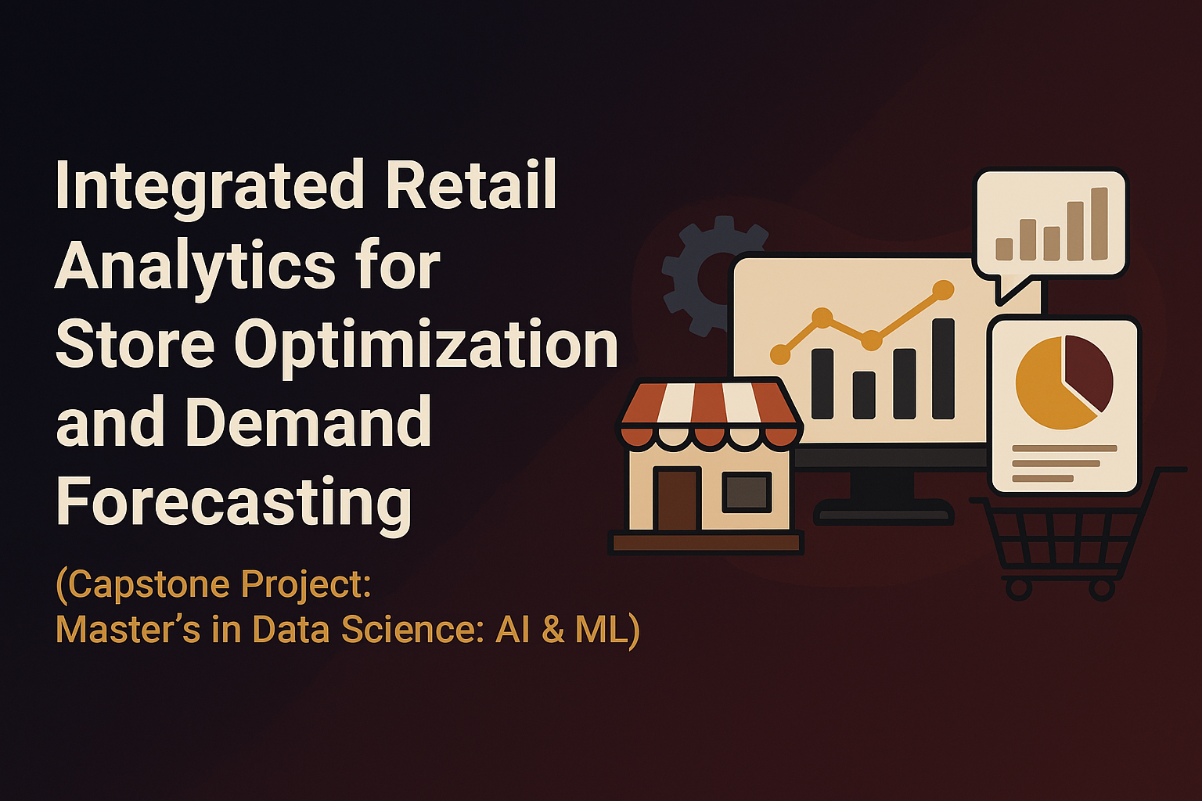
By Lokesh Todi

Slide 2

Project Objective
Leverage Data for Operational & Customer Experience Excellence:
Optimize store performance and forecast demand using machine learning models.
Enhance the customer journey through advanced segmentation and personalization.
Drive Sustainable Growth through Strategic Insight:
Cultivate long-term loyalty by delivering superior, data-driven customer experiences.
Continuously refine strategies based on market intelligence and customer feedback.

Slide 3
Project : table of content
🏠 Dataset Explained 🏠 Feature Engineering & Data Preprocessing 🏠 EDA – Exploratory Data Analysis 🏠 Anomaly Detection in Sales Data 🏠 Time-Based Anomaly Detection 🏠 Analysis of Customer Segmentation 🏠 Quality Evaluation of Segmentation 🏠 Strategies for Personalization 🏠 Personalization Strategies for Store Segments 🏠 Personalization Strategies for Department Segments 🏠 Market Basket Analysis 🏠 Forecasting Demand 🏠 Impact of External Factors 🏠 Real-World Application & Strategy Formulation 🏠 Conclusion

Slide 4
Dataset explained
Core Dataset: The analysis is based on historical sales records for a portfolio of 45 multi-department retail stores.
Key Features: The data is enriched with details on promotional markdowns, specifically those preceding four primary holidays (Super Bowl, Labor Day, Thanksgiving, Christmas).
Evaluation Metric: For model performance assessment, weeks that include these holidays are assigned a five-fold higher importance weight relative to non-holiday weeks.
The Business Case for Markdowns
Markdowns are a deliberate price reduction strategy used to drive sales and manage inventory. Their primary objectives are to clear aging stock, make way for new products, and recoup costs on unsold merchandise.
Feature Dataset
Store
Sales Dataset
Store (store number)
Date (the week)
Store Dataset
Store (store number)
Type (type of store)
Date
Temperature (average temperature in the region)
Fuel Price (cost of fuel in the region)
Markdown 1
Markdown 2
Markdown 3
Markdown 4
Markdown 5
CPI (consumer price index)
Unemployment (unemployment rate)
Is holiday
Department (department number)
Weekly Sales (sales for the given department in the given store)
Is holiday (whether the week is a special holiday week)
Size (size of store)

Slide 5
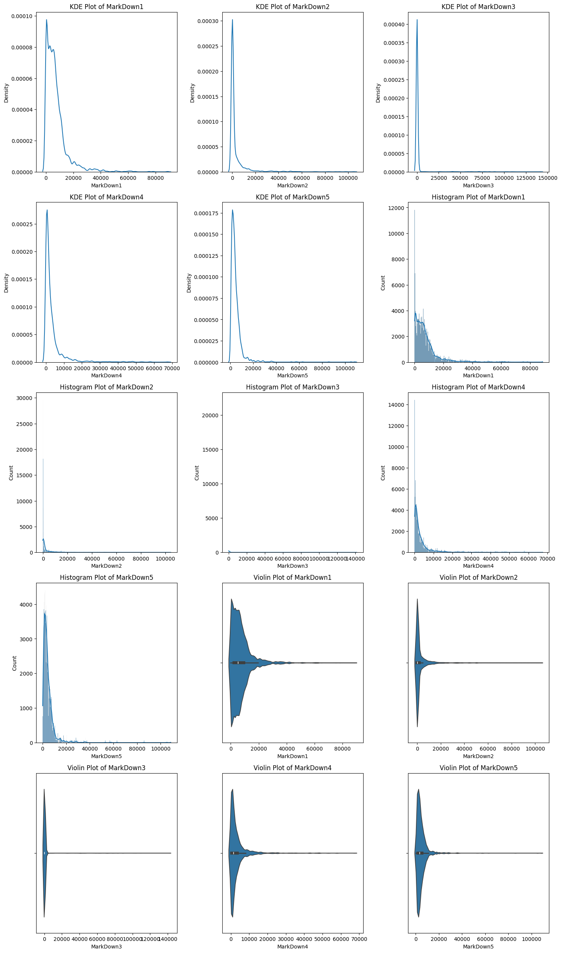
Feature Engineering & Data Preprocessing
Data Integration: All source tables (features, stores, sales) were joined to create a comprehensive master dataset.
Temporal Feature Engineering: The Date column was converted to a datetime data type, enabling the extraction of time-based variables.
Missing Value Imputation: Employed median imputation to handle missing values in markdown columns, ensuring a complete dataset while mitigating outlier influence.
Data Normalization: Transformed skewed numerical features using a square root function and scaled sales data with Min-Max normalization for model stability.

Slide 7
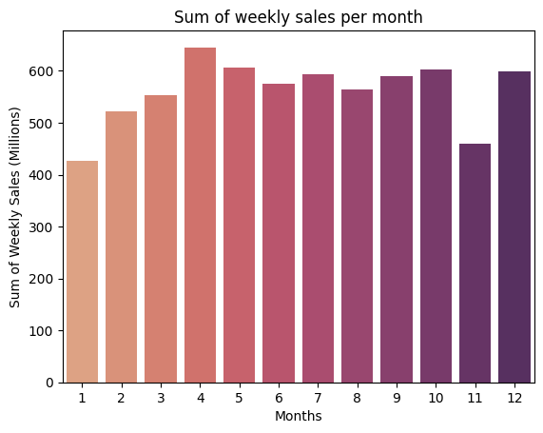
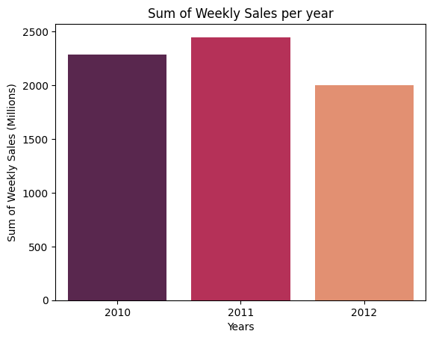
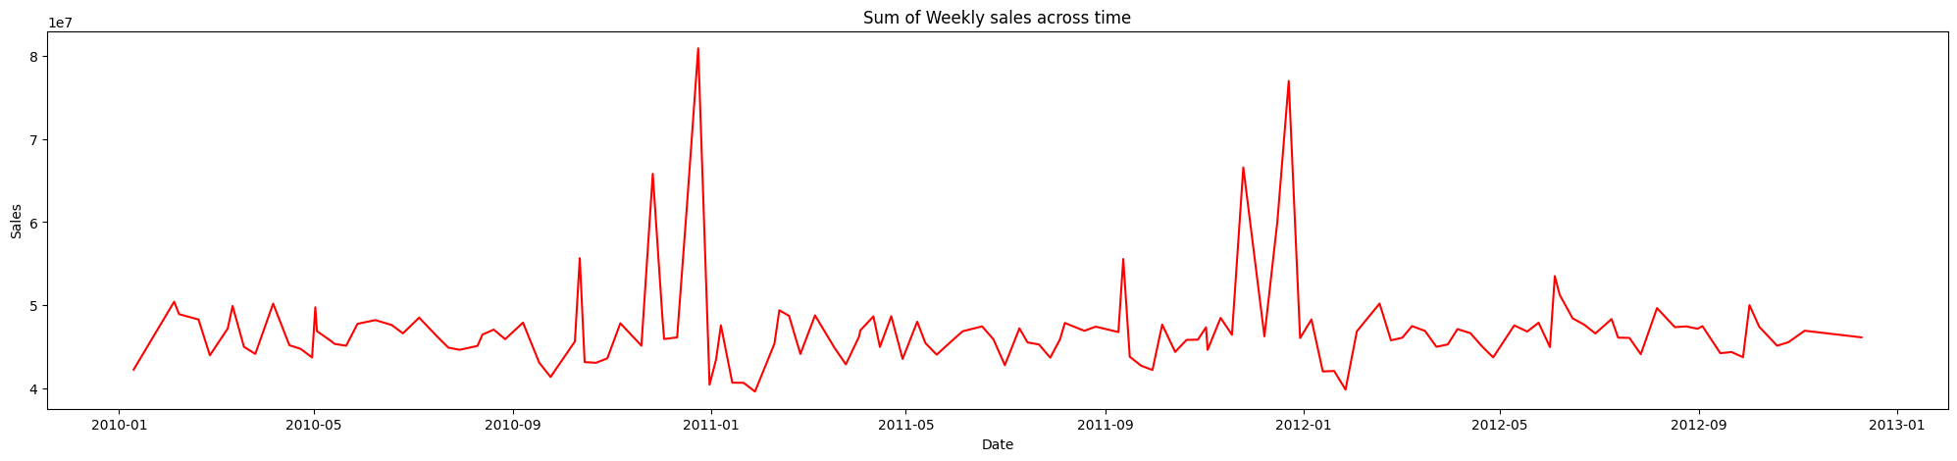
EDA - Exploratory Data Analysis
Key Insights from Time-Series Sales Analysis
Strong Seasonality: A distinct seasonal pattern is evident, with sales peaks directly correlating to major promotional periods, followed by predictable post-holiday declines.
Anticipatory Consumer Behavior: The pre-holiday sales dip, particularly in November, strongly suggests a pattern of deferred consumer spending ahead of major sales events.
Post-Peak Recovery Cycle: The data indicates a consistent sales recovery cycle that begins after the post-holiday trough, leading to a new baseline.
Data Anomaly Identified: An anomaly was identified in the December 2013 dataset. The observed sales figures are inconsistent with typical holiday performance, pointing to a potential data integrity issue.

Slide 8
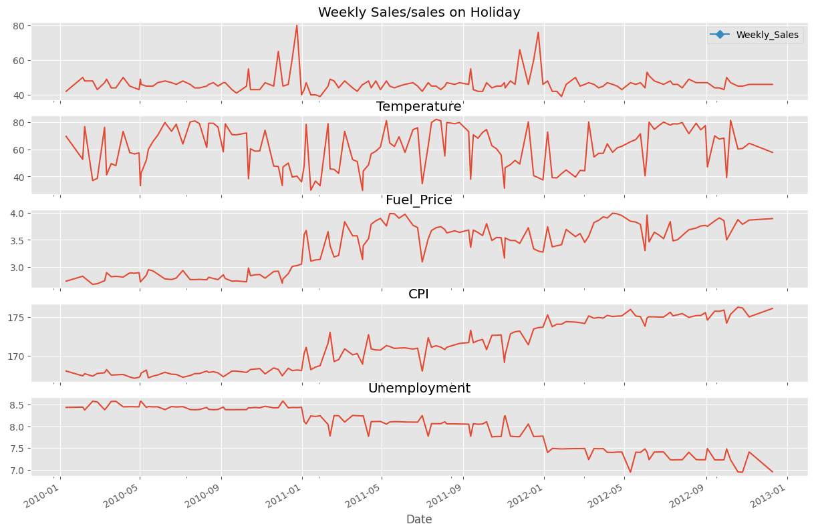
Seasonal Sales Dynamics:
Sales demonstrate significant peaks during Q4 (Nov-Dec) and major holiday periods.
Despite these seasonal uplifts, overall year-over-year growth remains flat, indicating a dependency on promotional cycles.
External Factor Analysis:
Economic Indicators: A steady increase in both the Consumer Price Index (CPI) and fuel prices was observed, alongside a consistent decrease in unemployment.
Environmental Factors: Temperature data shows no discernible trend ("random walk"), suggesting it is not a primary driver of long-term sales patterns.
Conclusion & Path Forward:
A comprehensive understanding of these sales patterns, store types, and departmental performance is essential for strategic planning.
These insights provide a data-driven foundation for optimizing inventory, refining sales forecasting, and tailoring marketing efforts to maximize revenue.

Slide 9
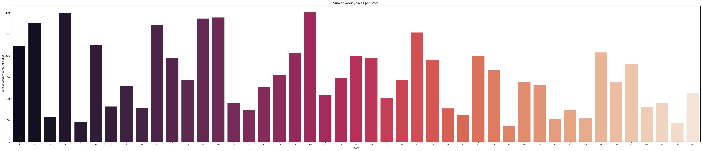
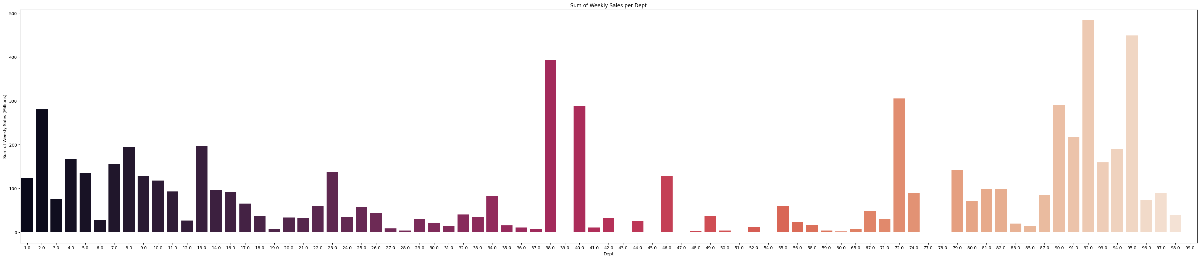
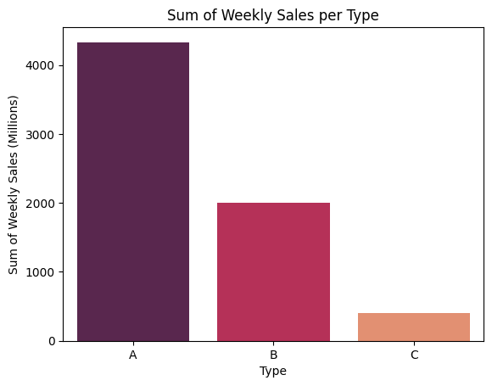
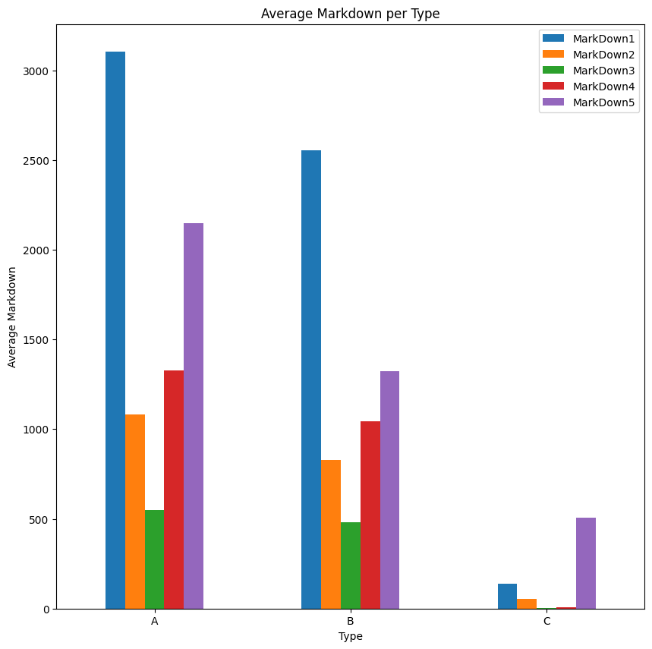
Which stores are the
highest earners?
Leaders: Stores 20 and 4 are the definitive top earners by sales volume.
Opportunities: Stores 44 and 5 represent the primary locations for performance improvement initiatives.
Which departments are the highest earners? Certain departments (1-15, 38, 40, 72, and 90-95) demonstrate notably higher weekly sales, with an average increase of 25%.
Which type of store is the highest earner?
Store type A, succeeded by store type B, were identified as the store types with the highest earnings, while store type C exhibited the lowest weekly sales.
Trend of markdown across types
Markdown1 is the highest for Type A, B while markdown 5 is the highest for type C

Slide 10
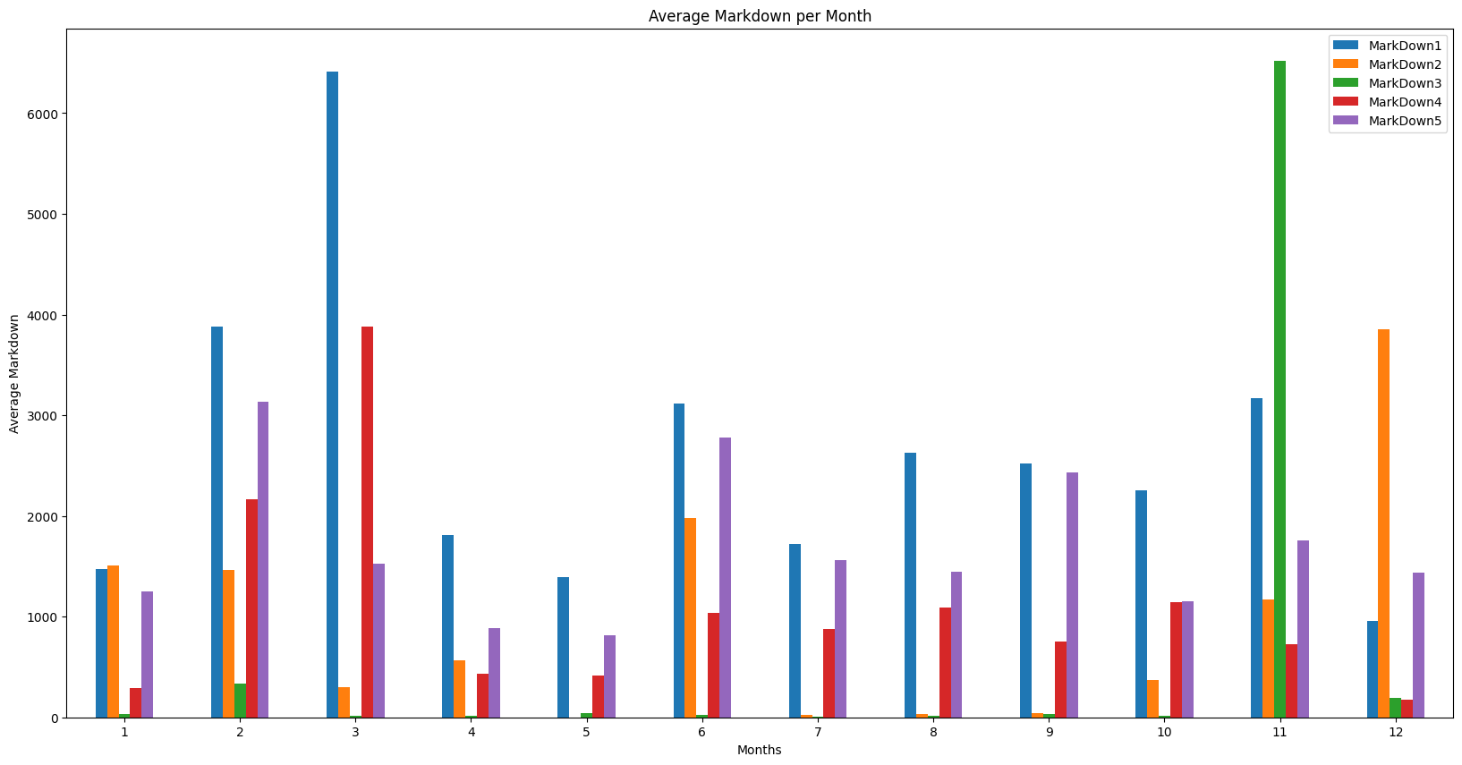
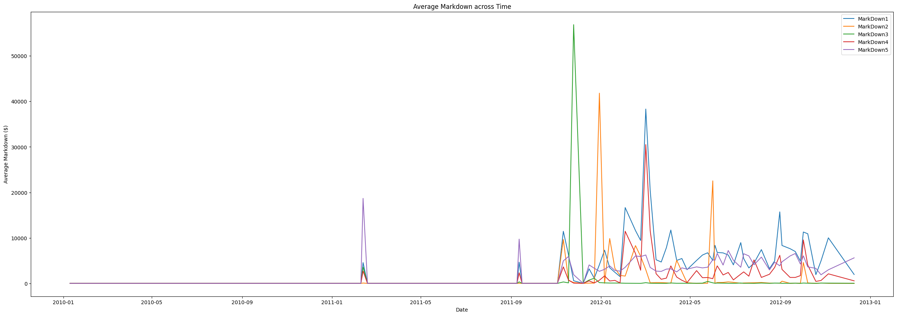
Trend of markdown across Months:
Our analysis reveals distinct seasonal patterns in the application of different markdown types.
Markdown 3: Activity for this markdown type peaks significantly in November, aligning with the major Q4 holiday promotional period.
Markdown 1: In contrast, this markdown shows its highest concentration during the month of March, suggesting a different strategic purpose, such as end-of-winter clearance.
Trend of markdown across Time:
Early Period (2011 - Q1 2012): This phase was dominated by large-scale, sporadic markdown events, likely corresponding to major seasonal or clearance campaigns.
Later Period (Post-Q1 2012): The data shows a clear evolution towards a more consistent promotional strategy, defined by a higher cadence of lower-value markdowns.
Interpretation: This pattern suggests a transition from periodic, large-scale inventory liquidation to a more agile and continuous promotional calendar.

Slide 11
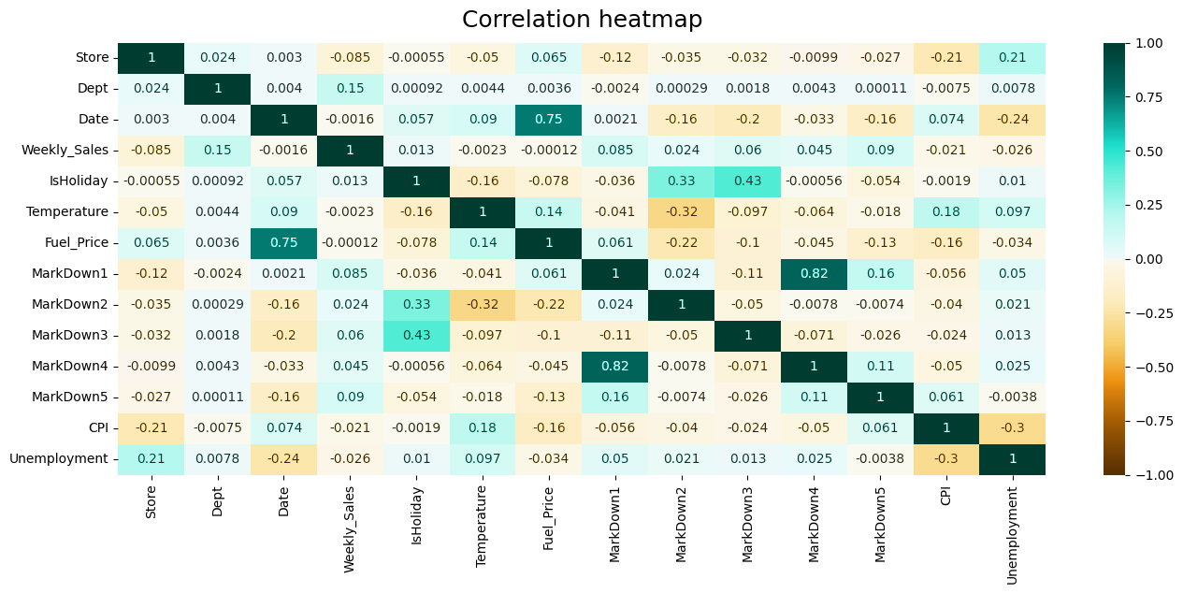
Correlation of factors and weekly sales
Internal Factors Drive Sales: Our weekly sales are not strongly correlated with external economic shifts, reinforcing that our own promotional strategies and holiday campaigns are the primary levers for driving revenue.
Macroeconomic Context: The analysis confirms expected inverse relationships between key economic indicators (CPI vs. Unemployment), providing a stable baseline for the market environment.

Slide 12
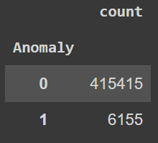
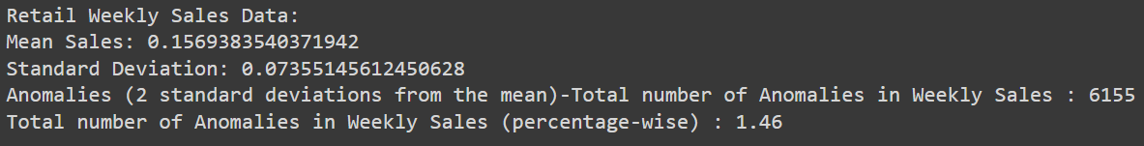
Anomaly Detection in Sales Data
Objective-
Identify unusual sales patterns across stores and departments.
Investigate potential causes (e.g., holidays, markdowns, economic indicators).
Implement anomaly handling strategies to clean the data for further analysis.
What is Anomaly?
Anomalies are deviations from expected behavior or patterns in data, and their presence can indicate issues or security threats.
Method used for Detecting Anomalies in Retail Data
Descriptive statistics are among the foundational methods for anomaly detection in retail. Techniques like mean, median, and standard deviation can be used to calculate summary statistics, which help identify point anomalies.
Mitigation Strategies
There are a number of strategies that can be used to mitigate the impact of anomalies without removing the data points. These strategies include:
Data cleaning: This involves identifying and correcting errors in the data. This can be done manually or using automated tools.
Data normalization: This involves transforming the data so that it is distributed normally. This can help to identify anomalies more easily.
Data imputation: This involves filling in missing data points. This can be done using statistical methods or machine learning algorithms.

Slide 13
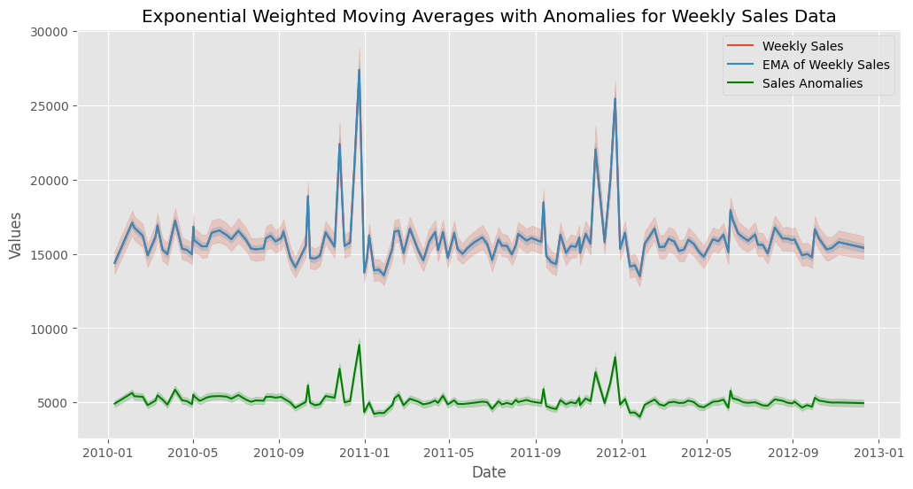
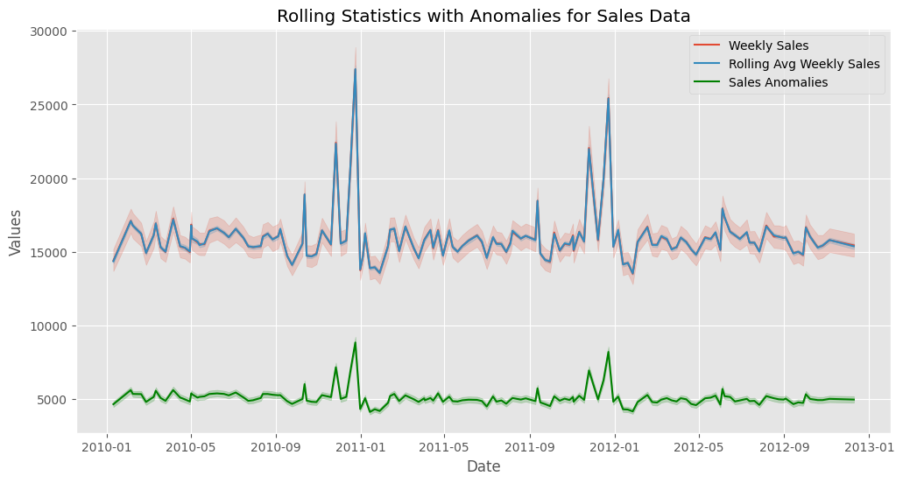
Time-Based Anomaly Detection
Objective:
Analyze sales trends over time.
Detect seasonal variations and holiday effects on sales.
Use time-series analysis for understanding store and department performance over time.
Detect anomalies in time series Sales data using specialized methods.
Approach:
Create Rolling Statistics: Calculate rolling averages, moving sums, and standard deviations to track data variations over time.
Apply Exponential Smoothing: Use exponential moving averages (EMA) and anomaly detection techniques to highlight unusual patterns in time series data.
Highlight Anomalies: Set thresholds and visual cues to identify significant deviations from smoothed values, aiding in anomaly detection and trend analysis.

Slide 14
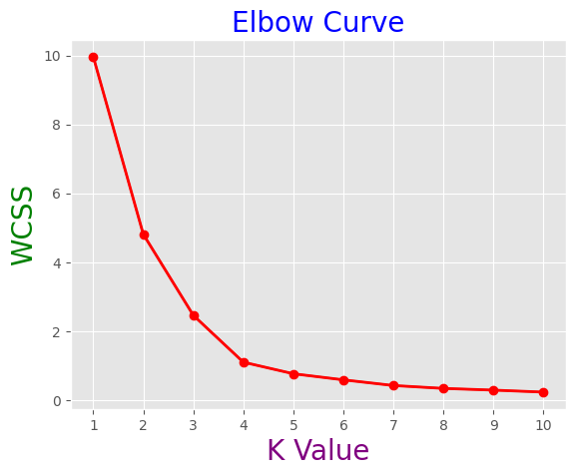
analysis OF Customer segmentation
Analytical Goal: To partition the store portfolio into discrete segments by leveraging sales, markdown, and regional features, thereby facilitating a granular analysis of each segment's unique profile.
Methodology: The segmentation was performed using K-Means Clustering. As an unsupervised learning algorithm, it is exceptionally well-suited for identifying inherent structures and similarities within a dataset without pre-defined labels.
Implementation: The algorithm iteratively grouped stores into clusters to minimize intra-cluster variance, resulting in data-driven segments optimized for internal similarity.

Slide 15
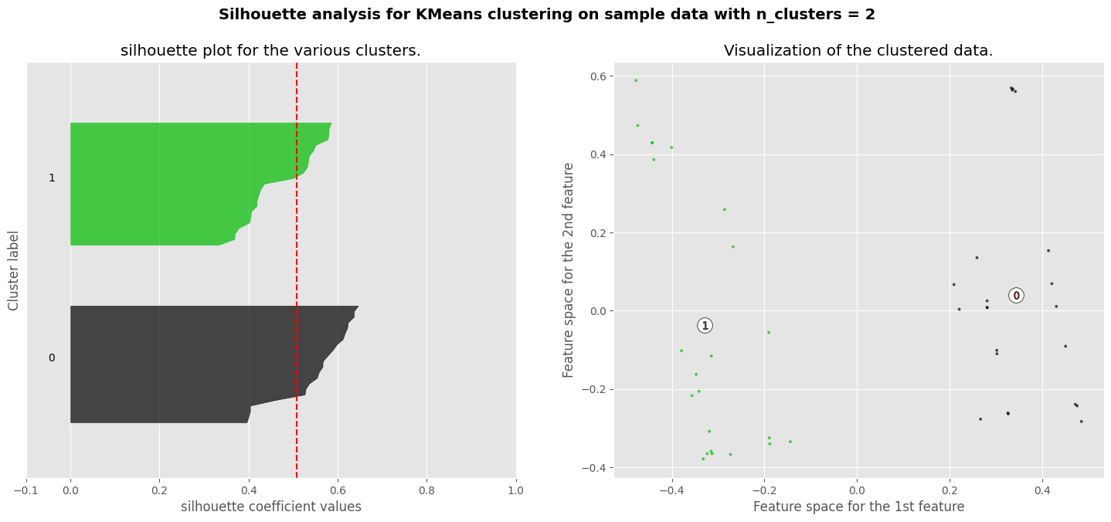
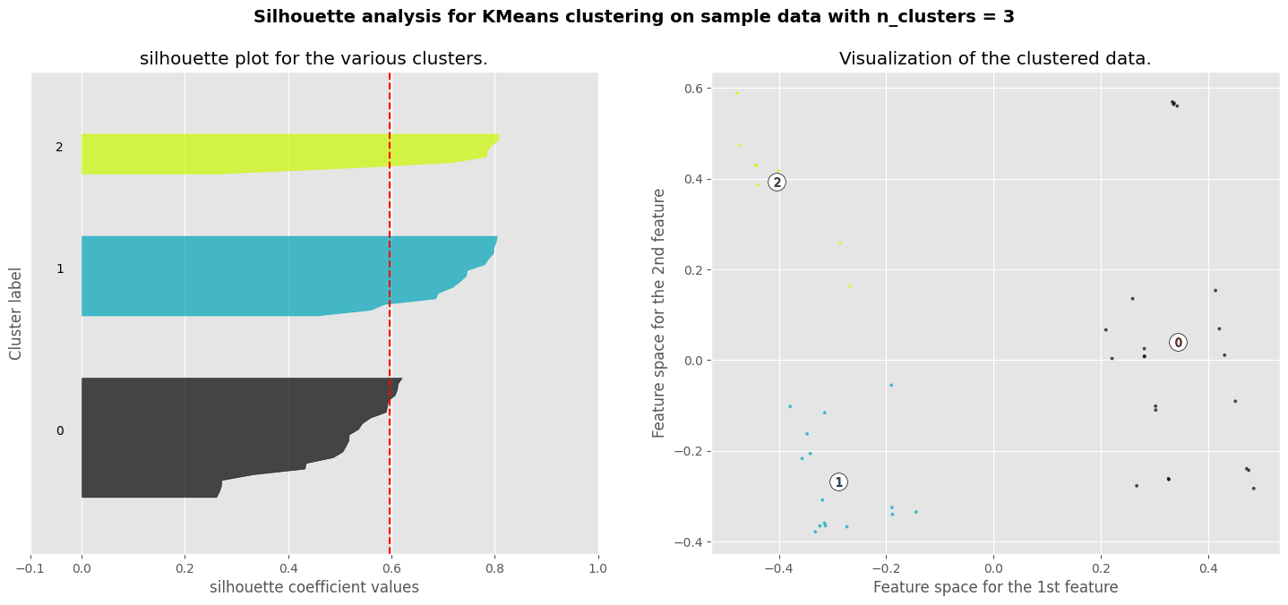
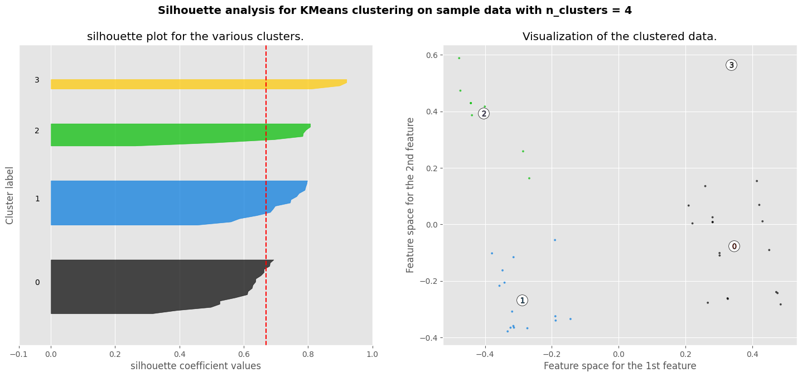
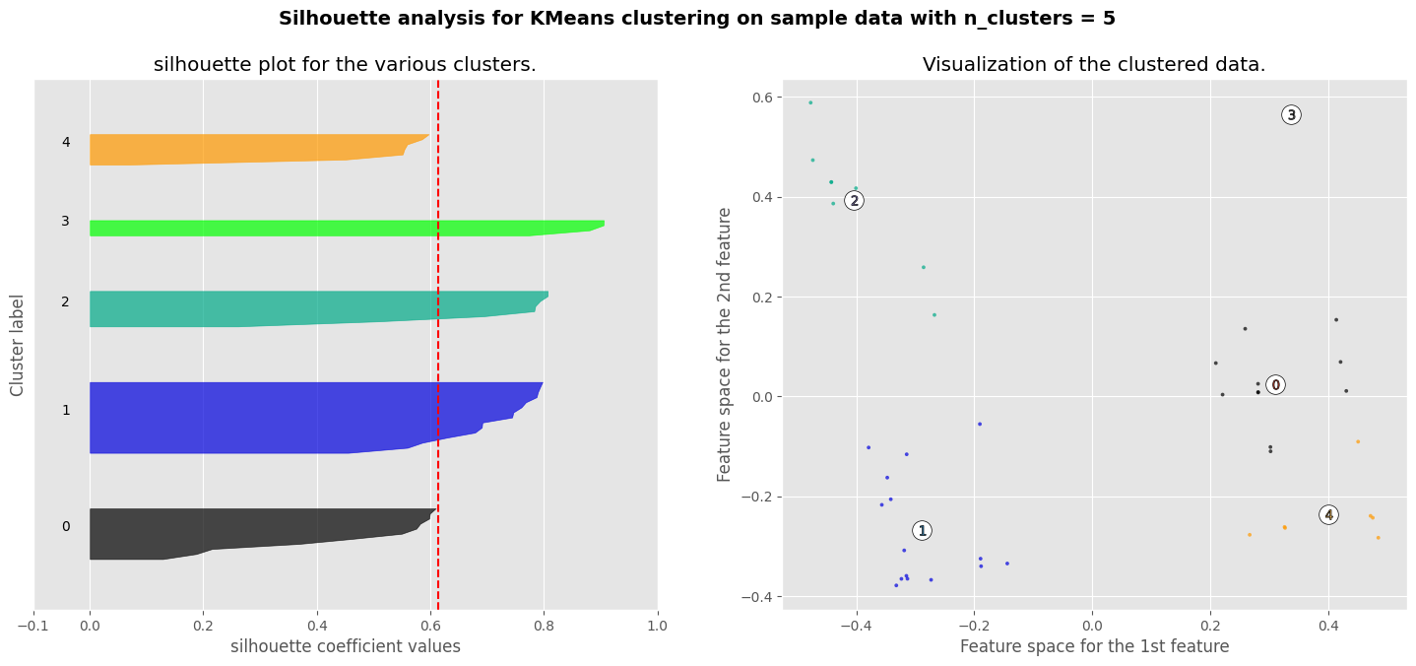
Quality Evaluation of Segmentation

Slide 16
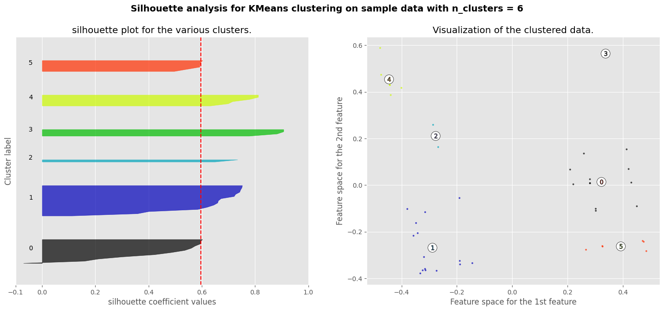
Validating Cluster Performance via Silhouette Analysis
The optimal number of cluster is 4 according to silhouette score
Rationale for Validation: The evaluation of segmentation quality is a crucial step to quantify cluster cohesion (intra-cluster similarity) and separation (inter-cluster dissimilarity). This validation is essential for confirming that the identified data structure is statistically significant and suitable for generating actionable insights.
Methodology:
Metric: Silhouette Score was selected as the primary metric for evaluating cluster performance.
Procedure: The score was calculated for various numbers of clusters (k) to identify the optimal partition.
Result & Interpretation:
The analysis revealed that k=4 maximizes the Silhouette Score for both store and department datasets.
This result indicates that a four-segment model provides the most distinct and well-defined representation of the underlying data structure.

Slide 17
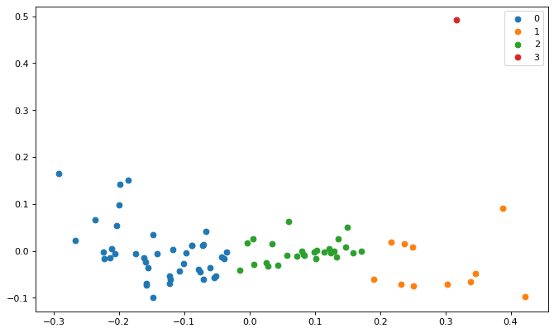
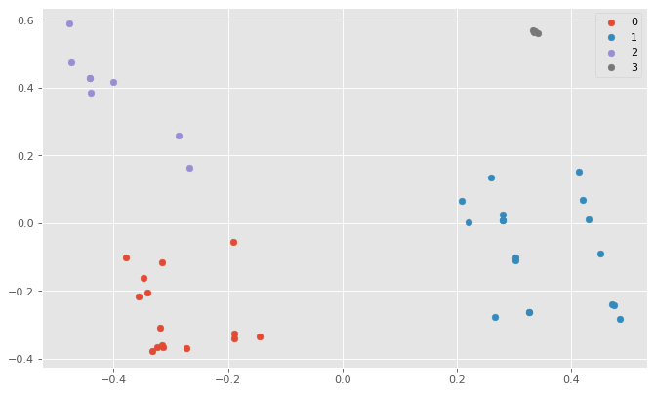
Strategies for Personalization
Strategic Recommendations: Marketing & Inventory
Core Objective: To leverage our store and department segmentation to develop targeted business strategies.
1. Personalized Marketing Strategies:
Action: Develop tailored marketing campaigns and product recommendations for each distinct segment.
Strategic Rationale: This approach is proven to enhance customer satisfaction, foster long-term loyalty, and increase engagement by meeting specific consumer needs.
2. Tailored Inventory Management:
Action: Implement segment-specific inventory policies based on unique sales patterns and demand.
Strategic Rationale: This directly optimizes costs by preventing overstocking, improves cash flow by reducing tied-up capital, and ensures product availability.

Slide 18
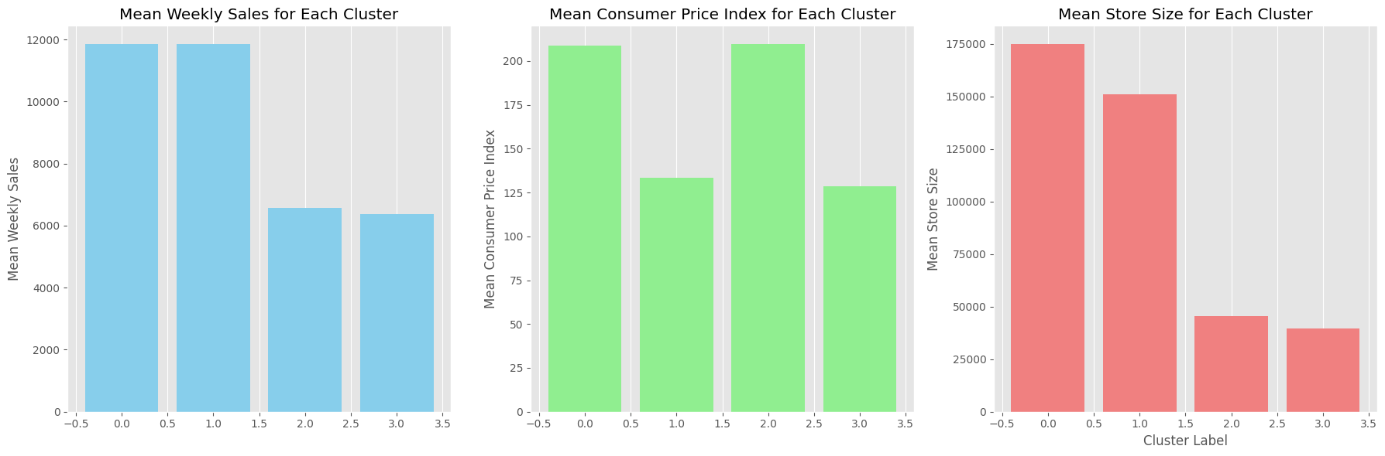
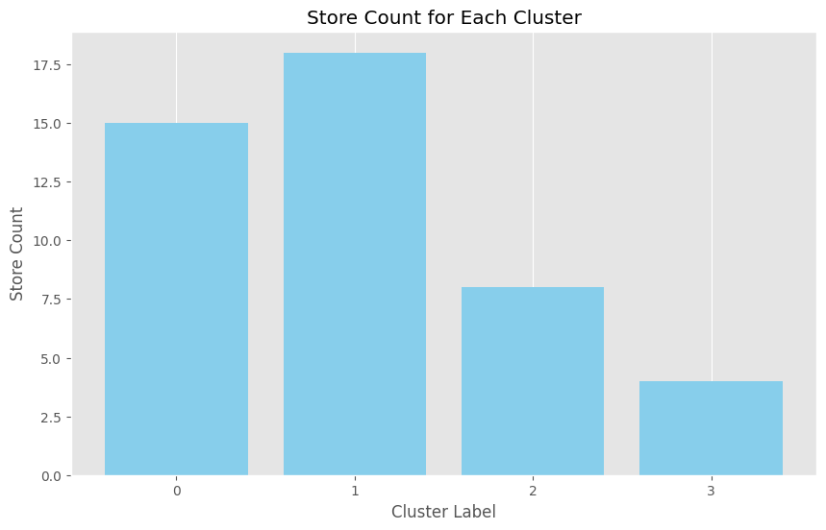
Personalization Strategies for Store Segments - Segment-Specific Marketing Strategies
Cluster 0: Premium & High-Volume Retailers
Marketing Focus: Emphasize the luxurious ambiance and spacious shopping environment.
Action Plan: Promote exclusive product lines and premium offerings to attract a high-value customer base.
Cluster 1: Value-Oriented Stores
Marketing Focus: Target value-conscious consumers by highlighting competitive pricing and promotions.
Action Plan: Deploy targeted digital advertising and social media campaigns to reach budget-focused shoppers.
Cluster 2: Budget-Friendly Stores
Marketing Focus: Center all messaging on affordability and value.
Action Plan: Utilize cost-effective channels like email marketing and local print/digital advertising to maximize reach.
Cluster 3: Compact Elegance Stores
Marketing Focus: Position as an exclusive boutique destination with a curated product selection.
Action Plan: Highlight the store's sophisticated ambiance and unique, premium offerings in all marketing materials.

Slide 19
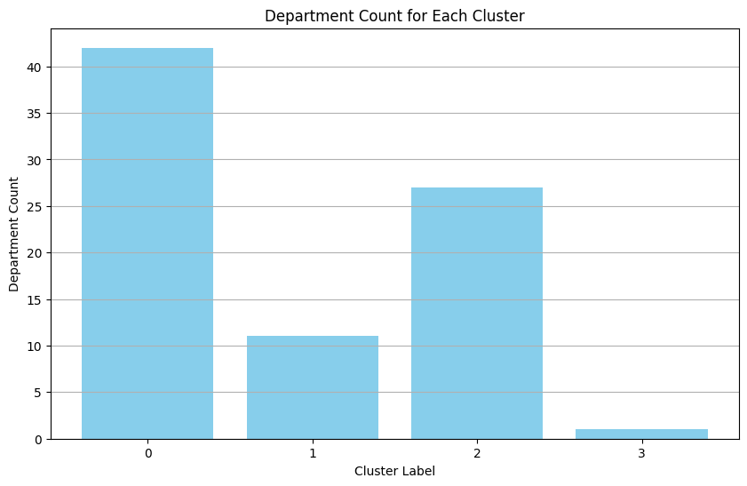
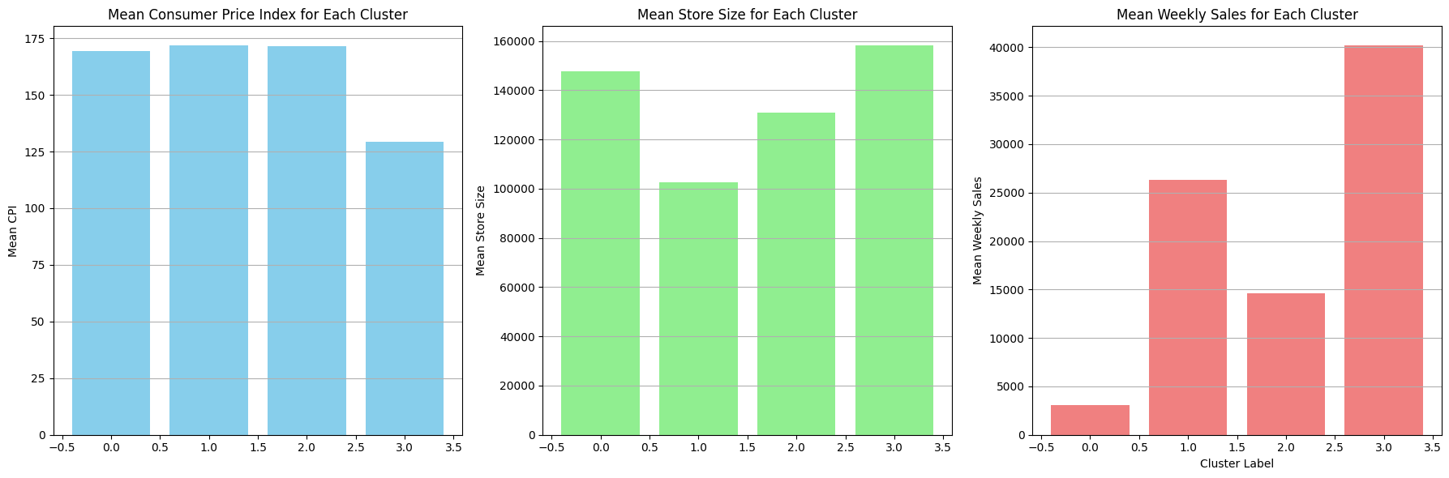
Personalization Strategies for department Segments : Department Marketing Playbook by Segment
Cluster 0: Flagship Luxury Departments
Positioning: Market as premier destinations, emphasizing their spacious, luxurious ambiance.
Action Plan: Promote exclusive product lines and premium offerings to attract and retain an affluent customer base.
Cluster 1: Curated Premium Departments
Positioning: Highlight the superior quality and exclusivity of the product assortment to appeal to discerning consumers.
Action Plan: Deploy targeted digital marketing and social media campaigns to engage a broader audience of luxury shoppers.
Cluster 2: Elite Boutique Departments
Positioning: Frame as exclusive boutiques offering a unique, curated selection of premium products.
Action Plan: Showcase the sophisticated, efficient, and intimate shopping experience in all marketing materials.
Cluster 3: Grand Outlet Departments
Positioning: Emphasize the extensive variety and breadth of product offerings to attract a wide customer base.
Action Plan: Utilize value-driven messaging that highlights affordability and competitive pricing to engage price-conscious shoppers.

Slide 20
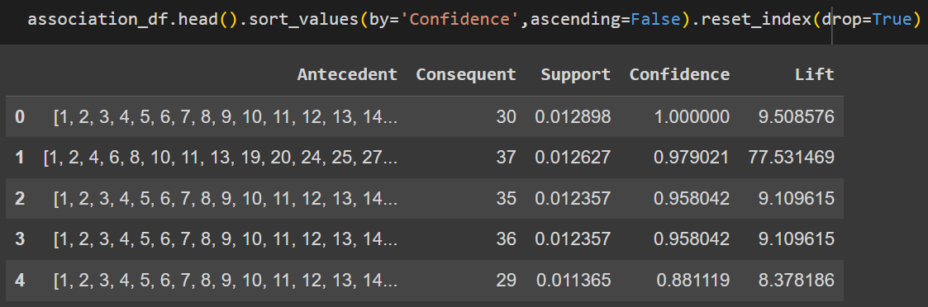
Market Basket Analysis - Rationale & Methodology
Analytical Objective: To identify significant purchasing patterns and product associations by analyzing transaction data at the department level within each store.
Strategic Objective: To leverage these identified associations to develop and implement effective, data-driven cross-selling strategies, thereby increasing average transaction value.
The Strategic Value of Market Basket Analysis:
A data mining technique used to identify products that are frequently purchased together.
By analyzing transaction data, it provides a data-driven blueprint for:
Developing effective cross-selling and promotional bundling.
Optimizing in-store product placement and store layout.
Improving inventory management and demand forecasting.
Algorithm Utilized: Apriori
We implemented the Apriori algorithm, a proven and widely adopted industry standard for association rule mining.
Its effectiveness in processing large transactional datasets makes it the ideal choice for this analysis.
The output of the analysis consists of association rules that reveal relationships between departments. Each rule specifies a set of items (antecedent) that are associated with another set of items (consequent). For example, a rule might indicate that when department 29 is present, items in stores 1, 2, 3, ..., 45 tend to be purchased together.

Slide 21
Market Basket Analysis -From Insights to Action
Methodology & Key Findings:
The Apriori algorithm was applied to transactional data to identify high-confidence associations between departments.
The analysis successfully generated actionable rules, such as identifying a high likelihood that customers purchasing from Dept. 29 also purchase from Dept. 30.
Data-Driven Strategic Recommendations:
Optimize Store Layout: Place highly associated departments (e.g., Dept. 29 and 30) in close physical proximity to encourage natural cross-purchasing and increase basket size.
Create Bundled Offers: For departments with strong co-purchase patterns (e.g., Dept. 35 and 36), develop compelling package deals and bundled promotions to incentivize a larger purchase.
Develop Targeted Promotions: Launch marketing campaigns that span multiple departments based on identified purchase patterns. For example, a promotion could link Dept. 37 with Depts. 1, 2, and 4.
Implement Dynamic Pricing: Utilize insights to inform pricing strategies, such as offering a strategic discount on a secondary product when a frequently associated primary product is purchased.

Slide 22
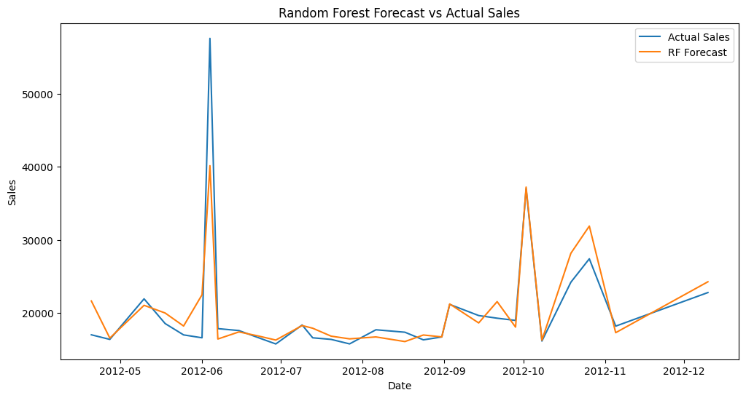
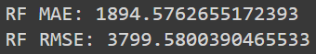
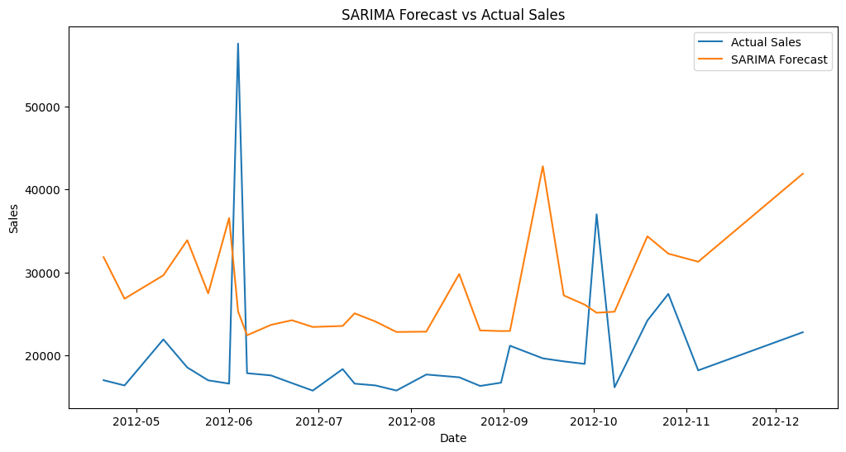
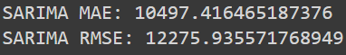
Forecasting demand
Primary Objective: To develop robust models that accurately forecast weekly sales at the store and department level. These models will incorporate both internal attributes and key external factors (CPI, unemployment, fuel prices).
Strategic Importance: Accurate demand forecasting is critical for optimizing operations. It informs inventory management, staffing levels, and financial planning, directly impacting profitability and customer satisfaction.
Dual-Model Forecasting Strategy:
Short-Term Model (SARIMA): Utilized for immediate operational decisions (weeks/months). This time-series model excels at capturing seasonality and recent trends.
Long-Term Model (Random Forest): Employed for strategic planning (months/years). This machine learning model effectively incorporates multiple external variables to inform long-range goals.

Slide 23
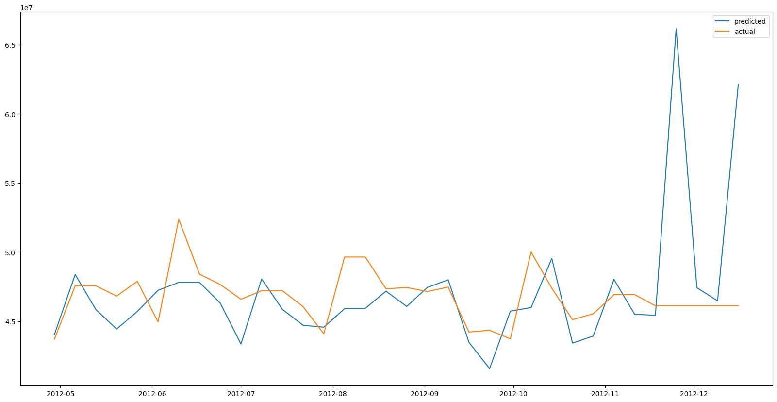
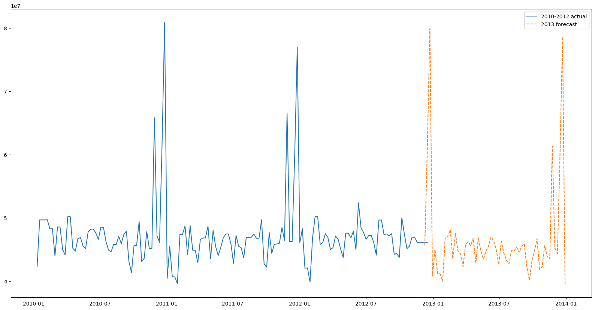
Forecasting 2013 Sales: The Holt-Winters Model
Objective:
To generate a reliable forecast of weekly sales for each store and department for the year 2013.
Methodology:
We employed the Holt-Winters model, also known as Triple Exponential Smoothing, for this time-series forecasting task.
Why This Model?
This model was specifically chosen for its ability to effectively capture and project the three core components of our retail sales data:
Level: The baseline average sales value.
Trend: The underlying rate of sales growth or decline over time.
Seasonality: The recurring weekly and holiday-driven patterns.

Slide 24
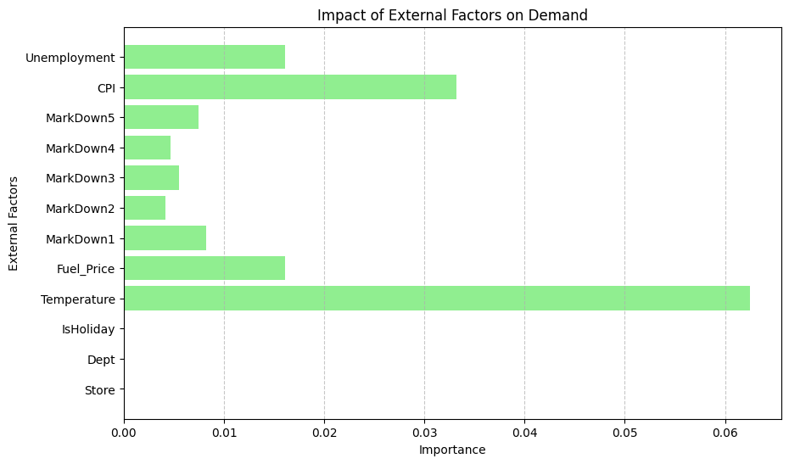
Impact of External Factors - Their Impact on Forecasting
Objective:
To quantify the impact of key external variables (climate, economic indicators) on sales performance.
To enhance the accuracy of our demand forecasting models by incorporating these influential factors.
Key External Factors Analyzed:
Temperature:
A direct driver of seasonal purchasing behavior. Analysis shows a clear correlation between temperature shifts and demand for climate-sensitive product categories (e.g., winter apparel vs. summer recreational items).
Consumer Price Index (CPI):
Acts as a measure of inflation and directly impacts consumer purchasing power and price sensitivity. This variable helps model shifts in overall consumer spending.
Fuel Prices:
A dual-impact variable affecting both business operational costs (logistics, supply chain) and the discretionary income available to consumers.

Slide 25
Real-World Application & Strategy Formulation
Strategic Applications: Inventory, Pricing & Supply Chain
Proactive Seasonal Inventory Management:
Leverage temperature forecast data to accurately predict seasonal demand shifts. This enables data-driven decisions on inventory allocation, ensuring optimal stock levels for climate-sensitive products and minimizing markdowns.
Agile Pricing & Promotion Strategy:
Integrate CPI data into pricing models to dynamically respond to changes in consumer purchasing power. During periods of low inflation, deploy targeted promotions to stimulate demand and maintain sales velocity.
Cost-Effective Supply Chain Optimization:
Actively monitor fuel price trends to proactively manage transportation costs. This data should inform the continuous optimization of logistics routes and distribution networks to mitigate the impact of price volatility on profit margins.
Data-Driven Marketing: From Insights to Campaigns
Geographically Targeted Campaigns:
Utilize regional climate data to tailor marketing campaigns with relevant product promotions. This ensures we are marketing winter apparel in colder regions while promoting summer gear in warmer areas, maximizing ad relevance and ROI.
Dynamic Pricing & Value Communication:
Leverage CPI data to model and understand consumer price sensitivity. This allows for strategic price adjustments to maximize revenue while ensuring our value proposition remains competitive and compelling in the market.
Strategic Promotional Timing:
Monitor fuel price trends as an indicator of consumer discretionary spending. This enables us to time major promotional events to coincide with periods of higher spending capacity, thereby capturing a larger share of wallet.

Slide 26
Real-World Application & Strategy Formulation
Strategic Store Optimization: A Data-Driven Framework
Data-Driven Product Placement:
Utilize temperature forecast data to inform seasonal store layouts and product adjacencies, highlighting relevant items to capture climate-driven demand.
Dynamic Inventory Management:
Leverage CPI data to model consumer spending patterns, allowing for the strategic adjustment of inventory levels to optimize turnover rates and minimize carrying costs.
Enhanced Customer Convenience:
When rising fuel prices impact consumers, proactively offer and promote convenience-oriented services like online ordering with flexible delivery to maintain customer loyalty and mitigate sales friction.
Implementation Roadmap: Key Challenges & Considerations
Successfully executing these strategies requires a proactive approach to the following challenges:
Data Integration: Ensuring the seamless integration of diverse data sources (temperature, CPI, fuel prices) into a unified system for accurate, real-time decision-making.
Resource Allocation: Committing the necessary budget and talent to support dynamic pricing models and data-driven marketing campaigns.
Operational Agility: Enhancing supply chain and inventory processes to respond rapidly to market fluctuations and shifts in consumer behavior.
Competitive Dynamics: Balancing data-driven pricing strategies with the need to maintain market share and profitability within a competitive landscape.

Slide 27
Conclusion
This project successfully established a framework to optimize store performance and enhance the customer experience through advanced segmentation and forecasting.
By integrating external factors (climate, CPI, fuel prices), we have gained a far deeper, more nuanced understanding of the forces shaping consumer purchasing behavior.
This enables a comprehensive strategy across inventory, marketing, and store operations, allowing us to move from reactive decisions to proactive, data-informed actions.
The result is the ability to deliver highly relevant, personalized experiences and adapt swiftly to market changes, securing sustainable growth and a significant competitive advantage.

Slide 28
Thank you !

